Slide 1
Year 2 Autumn 24
Dr D Wilson - diane.wilson@qub.ac.uk
Dr A McVeigh – a.mcveigh@qub.ac.uk

Slide 2
Year 2 Students’ Clinical Skills Teaching to date
Year 1
CSEC face to face teaching Autumn & Spring
3 Spring “Attachment” Clinical experience sessions – online & histories
Students have passed an 8 station summative OSCE at the end of year 1
Also Family Attachment and Clinical Communication Skills

Slide 3
Year 2 Student`s Clinical Skills AUTUMN 24
6 CSEC teaching sessions
5 afternoons teaching in GP Practice or Hospital
1 Self-directed learning (SDL) session – timetabled and supervised

Slide 4
Outline of Clinical Teaching in GP/Hospital
You have 10 timetabled teaching weeks
Your students have been divided into 2 groups each with 4 - 5 students
These groups will alternate and attend the GP or Hospital 5 times.
  Their FIRST EXPERIENCE of HOSPITAL or GP TEACHING
  ….. and possibly REAL PATIENTS
Notes:
As detailed later – you will Teach the same topic for 2 weeks

Slide 5
 | MONDAY dates | THURSDAY dates
Session 1 | 23 Sept | 26 Sept
 | 30 Sept | 3 Oct
Session 2 | 7 Oct | 10 Oct
 | 14 Oct | 17 Oct
Session 3 | 21 Oct | 24 Oct
 | 28 Oct | 31 Oct
Session 4 | 4 Nov | 7 Nov
 | 18 Nov | 21 Nov
Session 5 | 25 Nov | 28 Nov
 | 2 Dec | 5 Dec
Notes:
NOTE – not consecutive weeks – PROGRESS TEST mid November

Slide 6
Content of the GP /Hospital Clinical Teaching
Focus on practise of skills in the real setting
Includes NEW skills and skills previously taught in CSEC
Try to involve at least 2 real patients in each session
Expect prior preparation by students for these sessions – their student information is on CANVAS - consider “homework”
Notes:
Resources which are required are linked in the summary

Slide 7
TIMETABLE - Clinical Skills Experience : 2nd year Autumn Semester 2024
Attendance at the allocated HOSPITAL or GP PRACTICE
Session | TOPIC
1 | Introductions and orientation to clinical setting. *NEW* GI history taking Examination of the GI System /Abdominal Examination
2 | *NEW* Urinary History *NEW* Thyroid History
3 | *NEW Diabetic history taking Examination of Peripheral Pulses Measurement of BP
4 | *NEW Gynaecological history Ear Examination Cranial nerve examinations
5 | *NEW Headache and Collapse histories Motor and Sensory examinations

Slide 8
Resources for Y1+2 Clinical Experience
Summary Clinical Skills Attachment Teacher Guide - Autumn 24
Contacts, Timetables, Relevant website links, Suggestions
Clinical Skills website https://www.med.qub.ac.uk/portal/Account/Login.aspx
Full details of Clinical Skills, DOCS proformas
Quick Reference Guide QRG (now also available in e-format on Clinical Skills website)

Slide 9
Student evaluation
Student evaluation has been extremely positive overall
Some students comment on differences in approach to skills between teachers. Many differences are acceptable within clinical practice.
  For standardisation of approach please always refer to the medical portal pages
Some students highlighted lack of alignment with other teaching. The timetabling of clinical skills teaching however has taken into account various important points and tried to balance the students’ learning needs.
  Please stick to the timetable of skills
Students compare experience with peers and little or no provision of patient contact is expected
  Please try your best to organise patients week to week

Slide 10
Feedback
Give immediate verbal feedback
Consider using DOCS - specific detailed feedback
NEW Mini- CEX forms - ‘My Progress’ PORTFOLIO App
Online Mini-CEX forms are completed on the student`s phone.
Please complete ONE for each student during autumn.
Notes:
Any skill is suitable for mini CEX – generic details on the mini CEX form
You will need to give you name / email address to the student to verify the completion

Slide 11
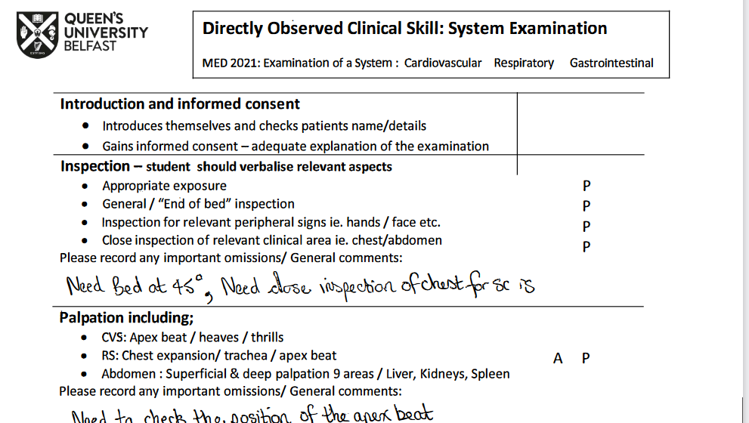
https://www.med.qub.ac.uk/portal/cskills/students/DOCS.aspx
Feedback tools and ** NOT OSCE MARKING SHEETS **

Slide 12
Exceptional Circumstances
Keep contact details for the group – student representative
In exceptional circumstances, you may need to use an alternative date to deliver a teaching session - Monday 9 & Thursday 12 December
Attendance
100% attendance at these sessions is expected. Please keep a record of attendance. Contact CSEC staff if a student misses more than 1 session.
In the case of illness, please allow students to swap within their group to maximise these face-to-face teaching opportunities.
Should you have any specific concerns regarding any student within your group or issues with attendance, it is important you contact CSEC staff and bring it to their attention as soon as possible.

Slide 13
Any questions?

Slide 14
THANK YOU

Slide 15
and
Enjoy!

Slide 16

End slide

